Slide 1


Acreditare ERASMUS – mobilitatea 1
JOB-SHADOW – 3 profesori
25 – 29 aprilie 2023

Slide 2
Content
Belgian educational system
GO!
Atheneum Herzele
Innovative system - self regulated learning
Week schedule

Slide 3
Belgian Educational System
2,5 - 5 → kindergarten
5 - 11 → primary education
12-18 → secondary education
18 - … → higher education
Compulsory schooling starts at 5 years old
special primary education special secondary education

Slide 4
Secondary education
12 - 14 → A or B-current
15 - 18 → ASO/TSO/BSO
A-current | B-current
ASO (general secondary education) | BSO (vocational secondary education)
TSO (technical secondary education)

Slide 5
Core values GO!
mutual respect
sincerity
equality
openness
commitment

Slide 6
GO! Atheneum Herzele
School group 20 → Isabelle Truyen
Sandy Maegerman & Barbara Fernandez
815 students
120 teaching staff
12 non-teaching staff

Slide 7
Innovative system - SRL
breaking up lessons → weekly planning
classification (hero, superhero, powerhero)
tests and exams
tailoring the system to the target group
short instructions
learning disabilities

Slide 8
Innovative system - SRL
focus on interests and talents;
teacher no longer central;
chromebook as class tool;
remediation processes;
additional challenges: learning disabilities;
time
team teaching

Slide 9
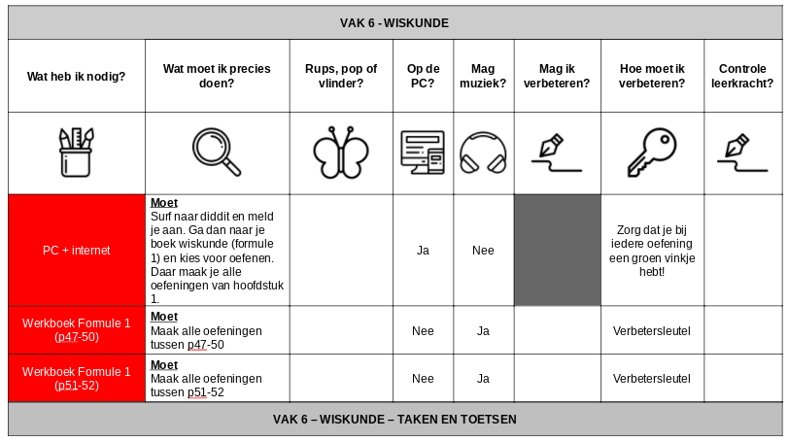
Innovative system - SRL
Subject 6 - MATHEMATICS
Caterpillar, pupa or butterfly?
On the PC?
Is
music allowed?
Can I improve?
How should I improve?
Control teacher?
What do I need?
What exactly should I do?
Must
Surf to diddit and sign up. Then go to your math book (formula 1) and choose practice. There you do all the exercises from chapter 1
Make sure you have a green check mark for each exercise
Must
do all exercises between p 47-50
Enhance key
Must
complete all exercises between p 51-52
Enhance key
Subject 6 – MATHEMATICS – TASKS AND TESTS

Slide 10
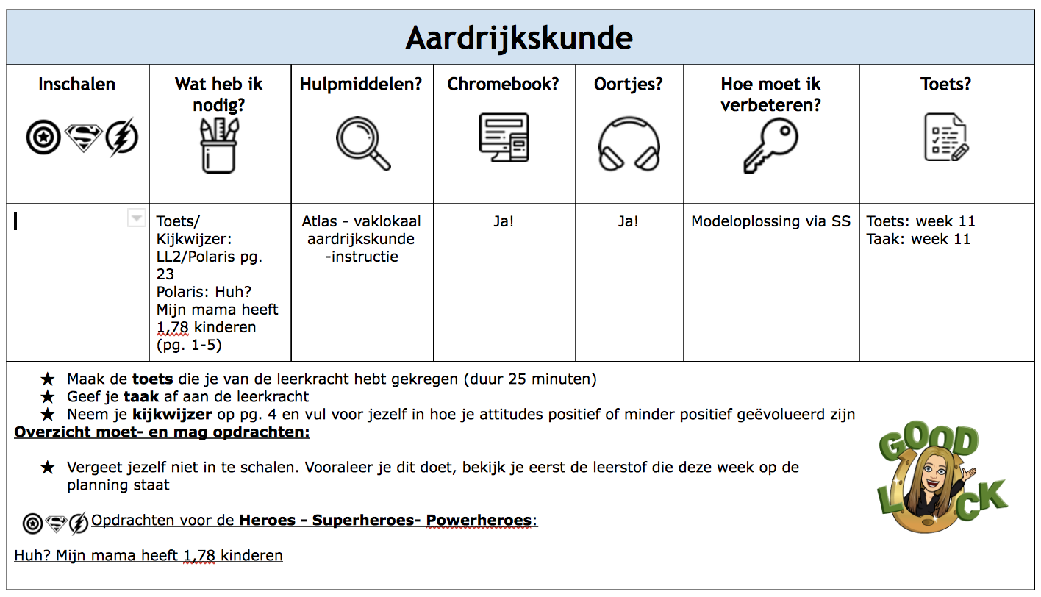
Innovative system - SRL
GEOGRAPHY
SCALING IN
What do I need?
TOOLS?
How should I improve?
TEST?
Test / Viewing pointer: Polaris, pg. 23 Polaris: Huh, my mom has 1,78 children
Test: sapt 11
Assignement:
sapt 11
Take the test you received from the teacher (duration 25 minutes)
Hand in our task to the teacher
Take your viewing guide on pg.4 and fill in for yourself how your attitudes have evolved positively or less positively
Overview must and may assignments:
Don’t forget to rate yourself. Before you do this take a look at the material that is planned for this week.
Missions for the Heroes – Superheroes – Powerheroes:
Polaris – Huh, my mom has 1,78 children

Slide 11
Innovative system - coaching
student is not a number;
student guidance in teacher's hands;
student supervisor functions as support for teacher;
good connection between student and coach
socio-emotional development
follow-up school career

Slide 12
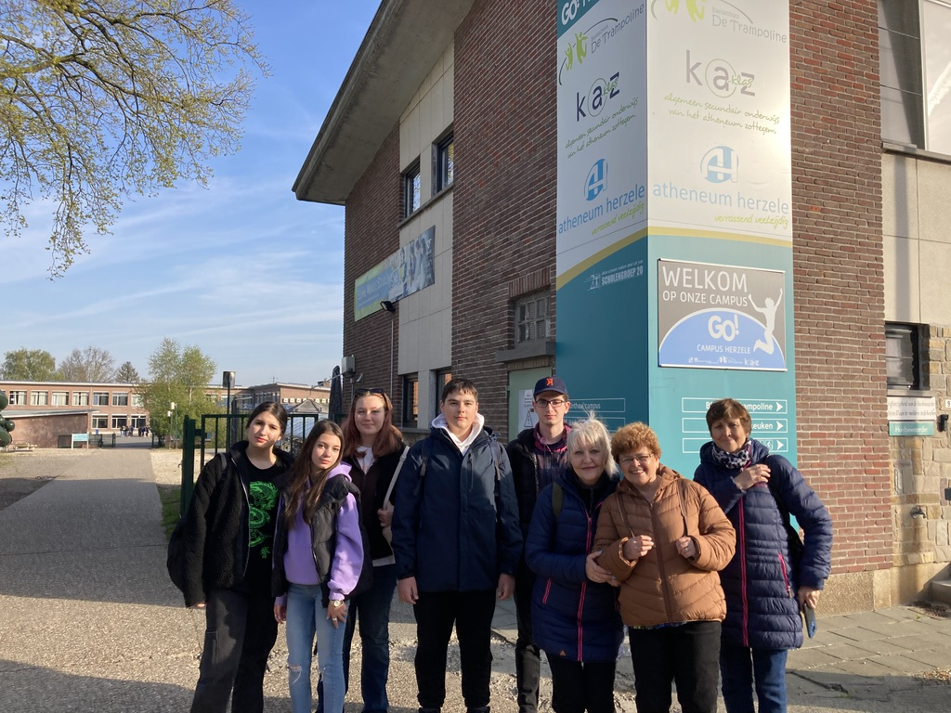
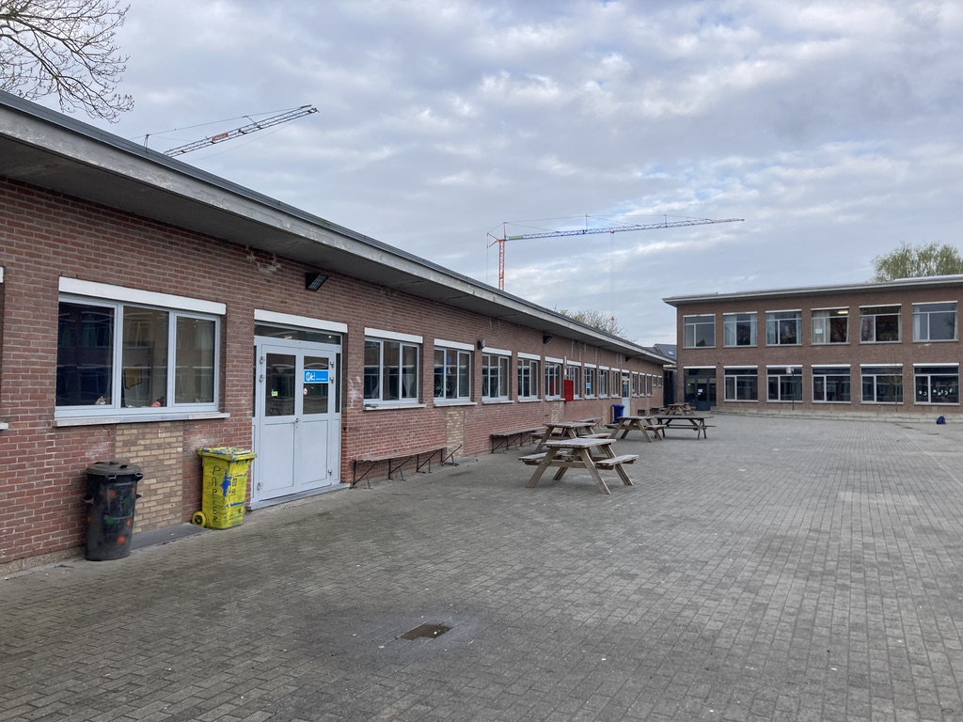
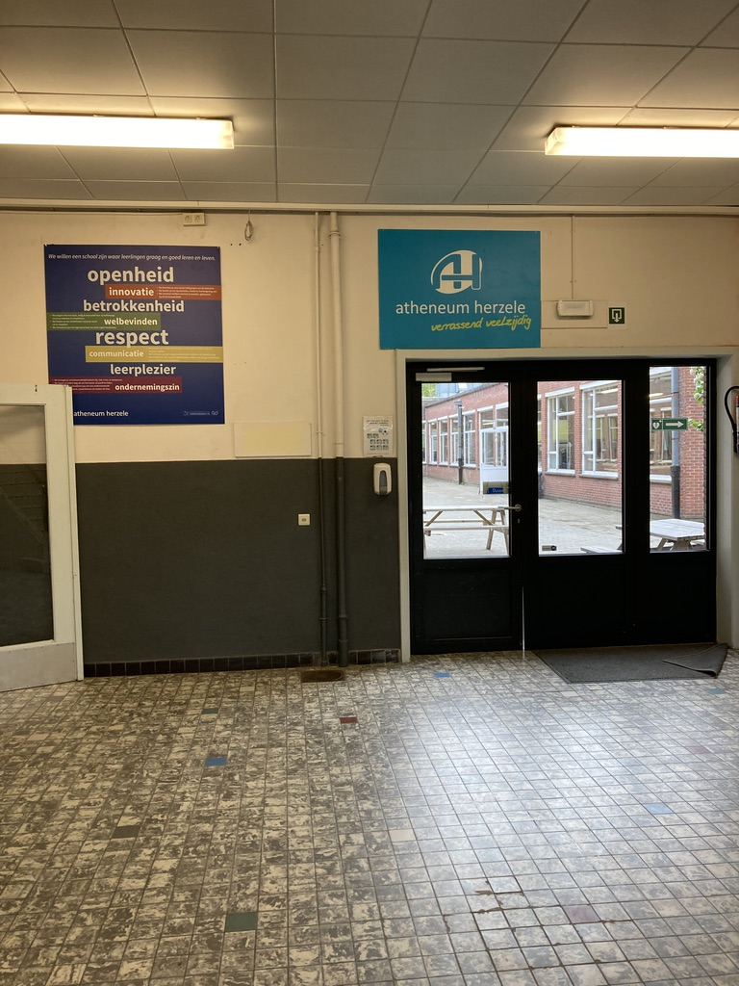
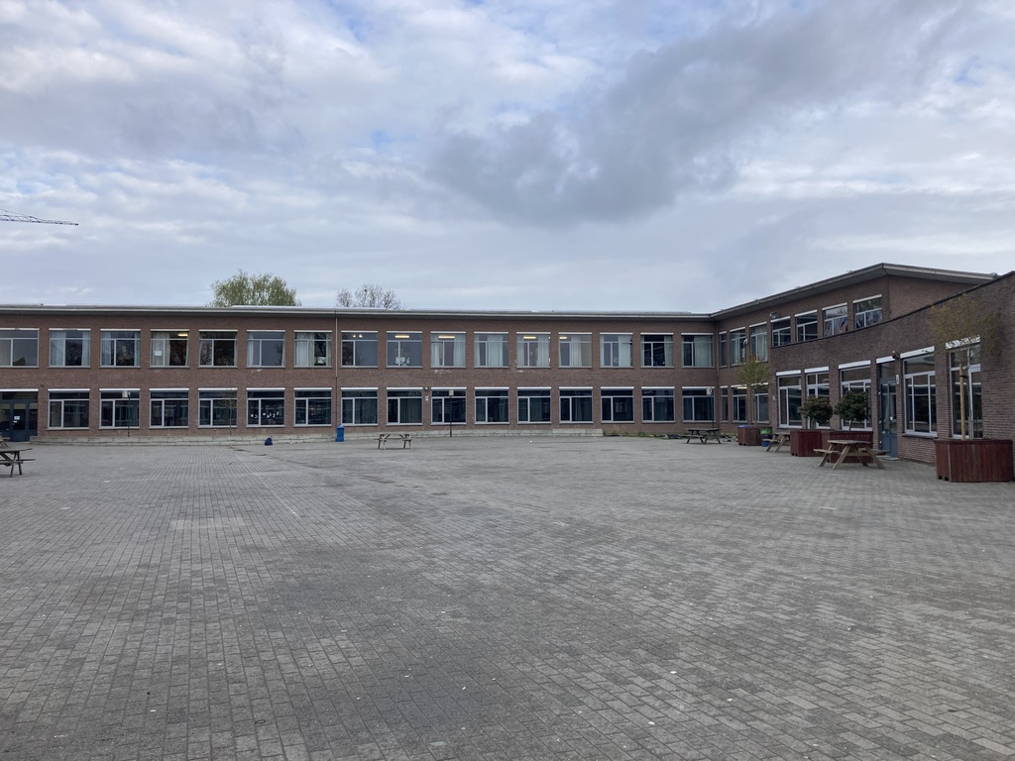
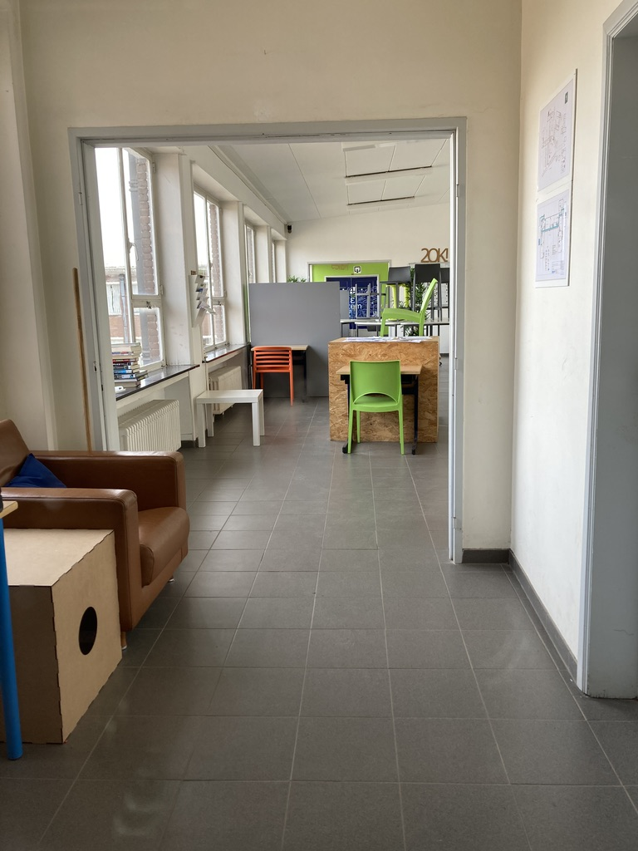
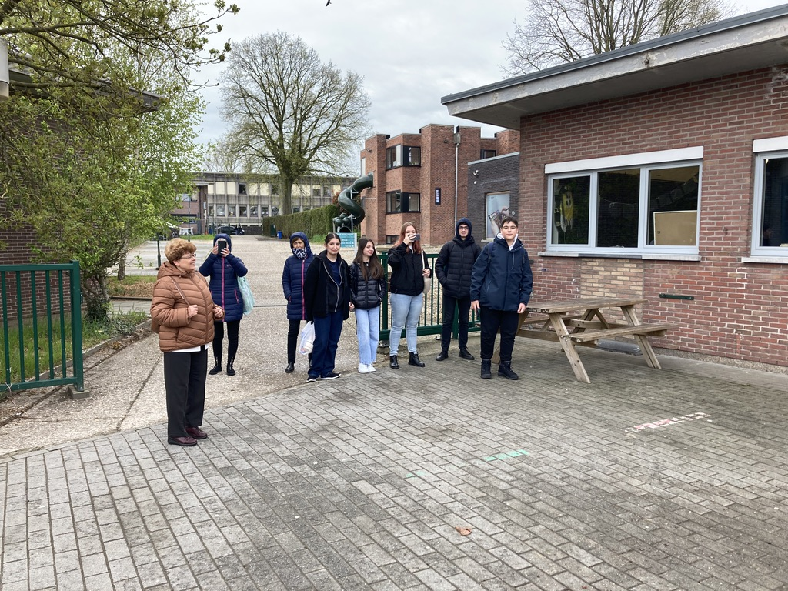

Slide 13
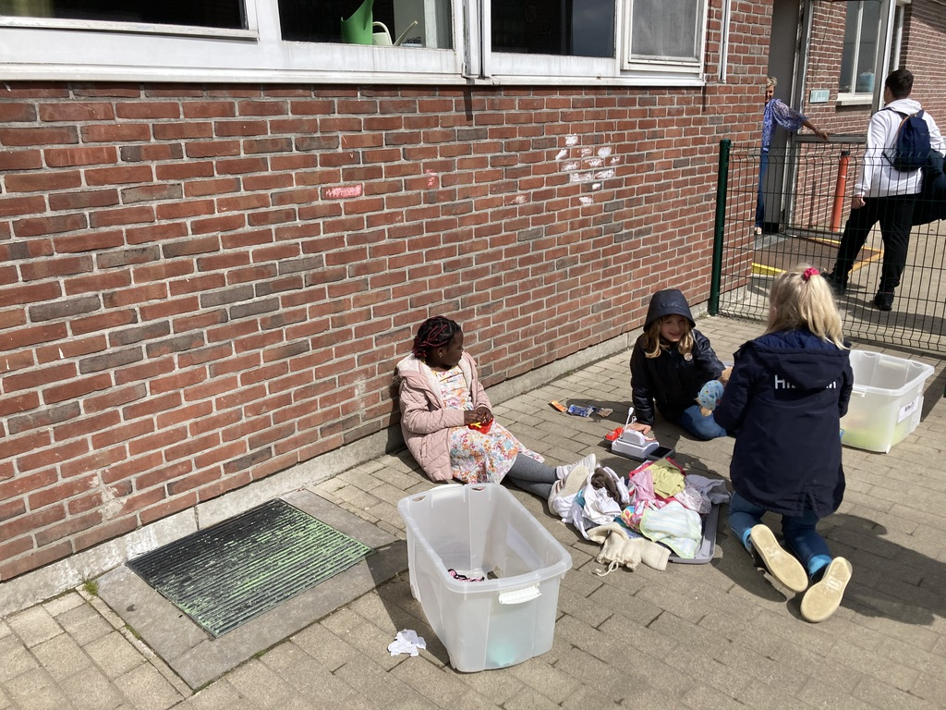
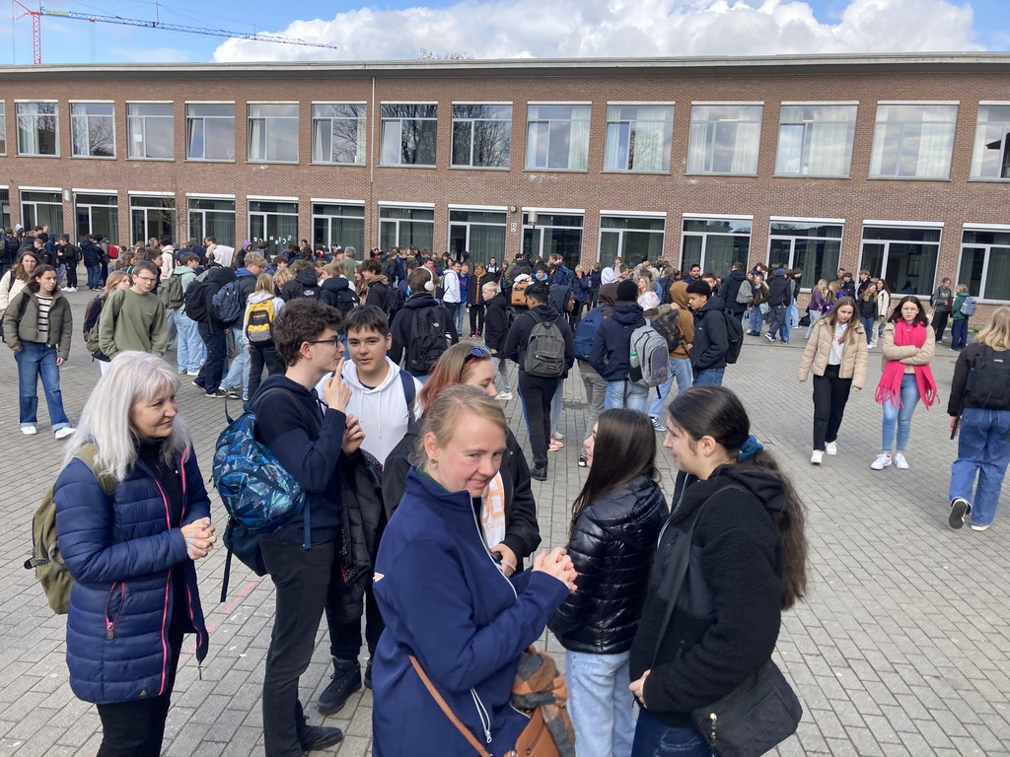
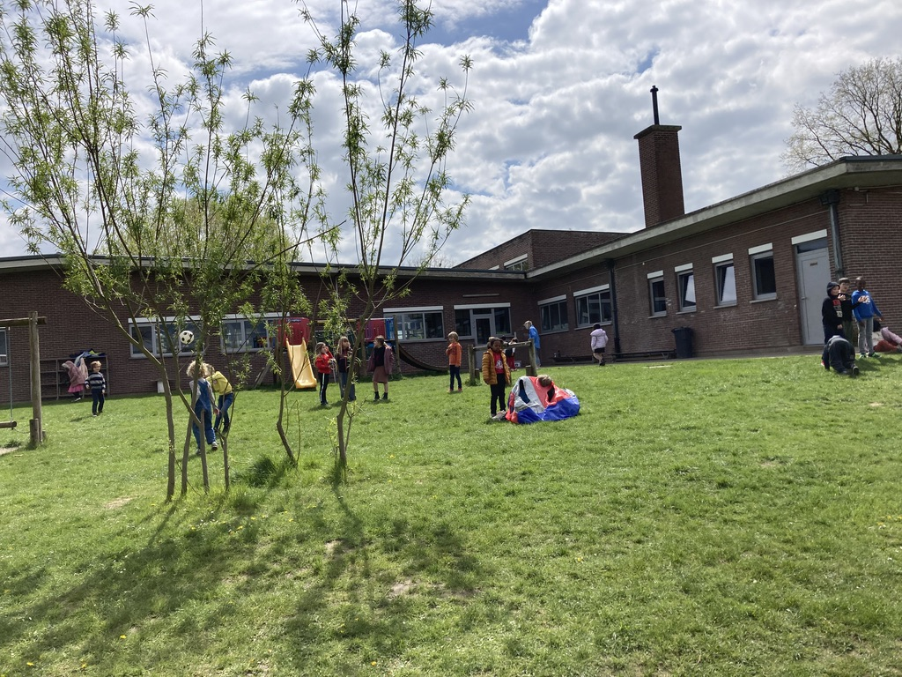
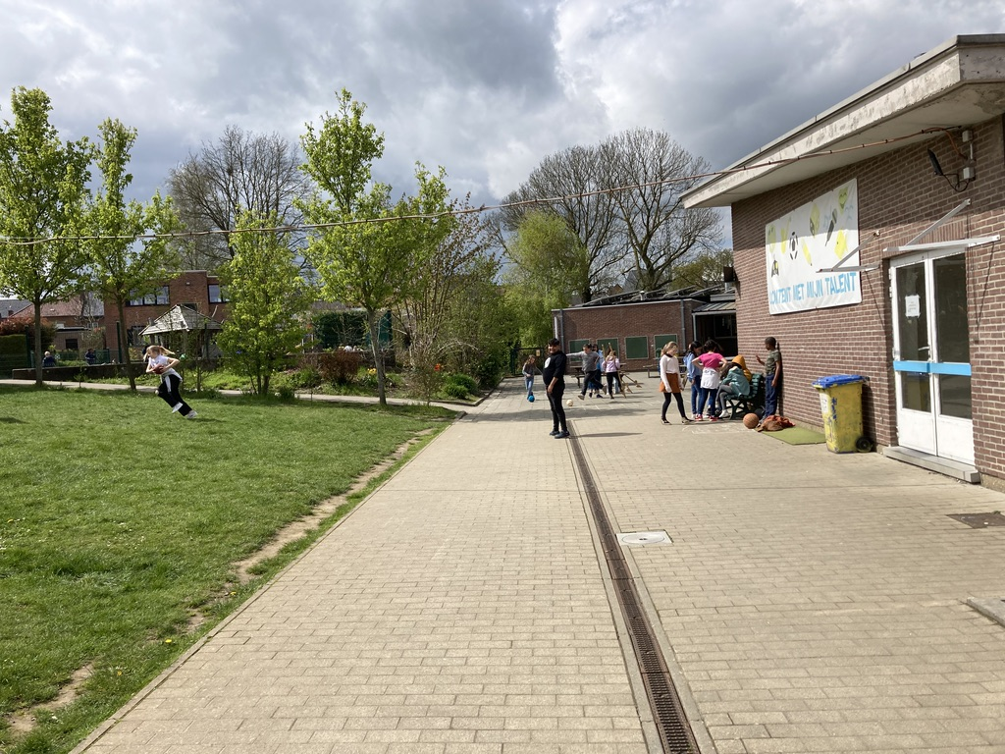

Slide 14
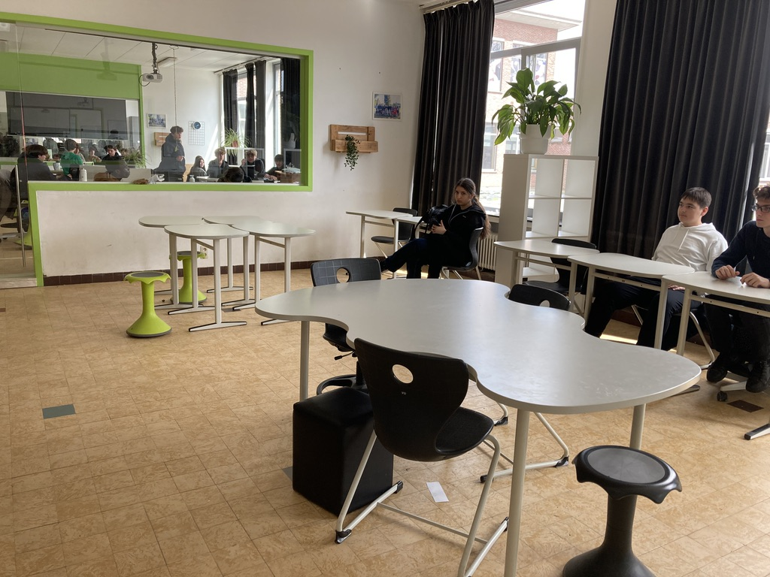
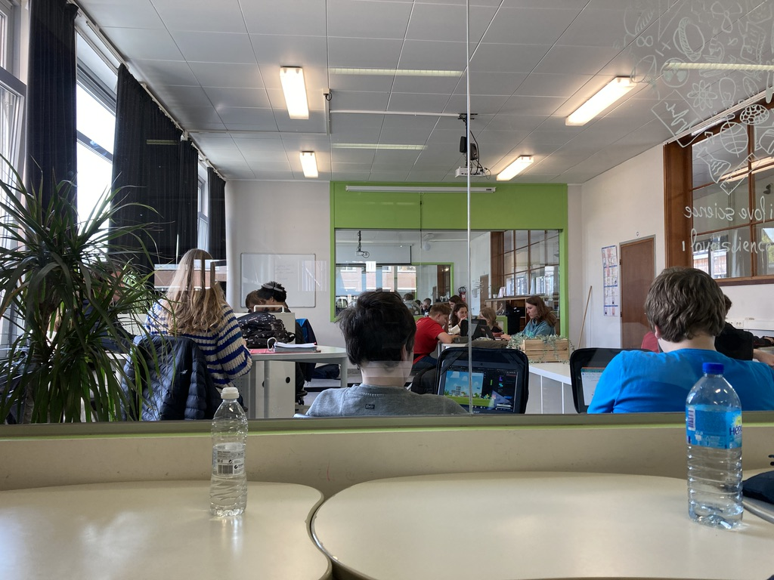
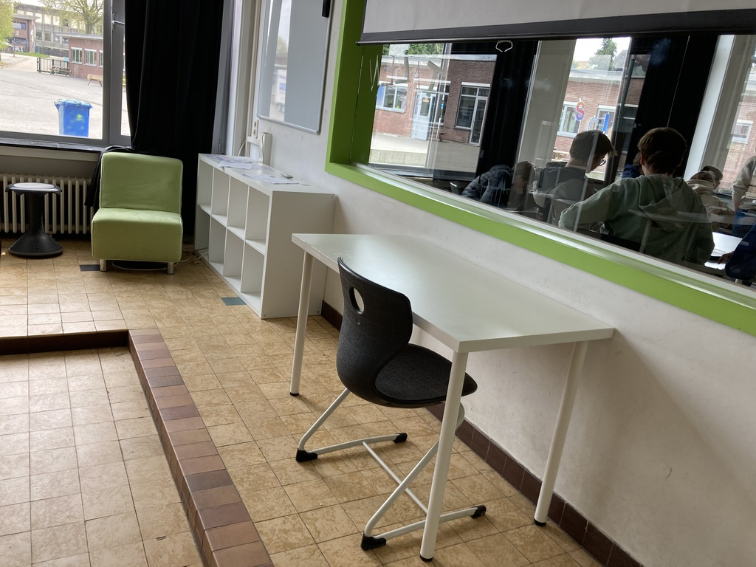

Slide 15
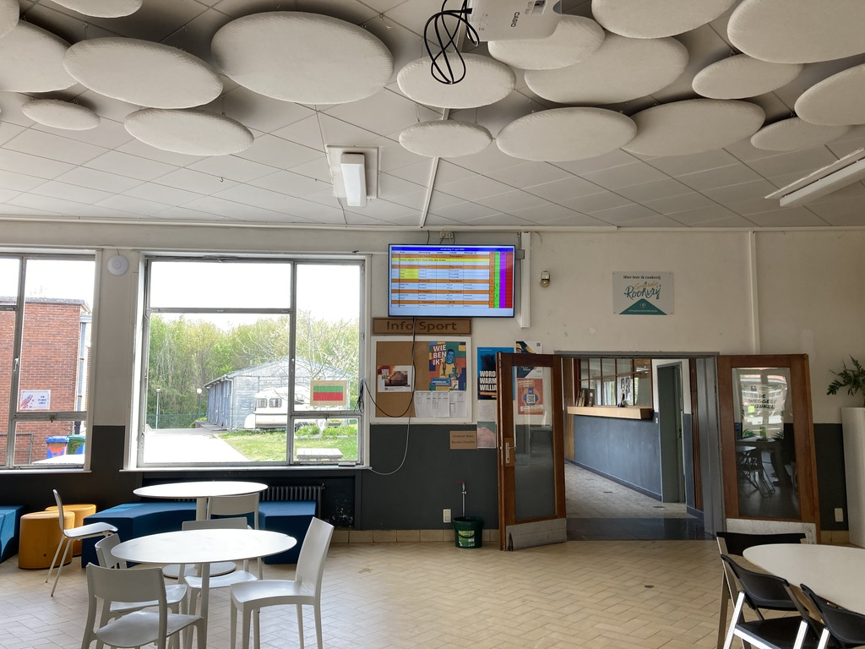
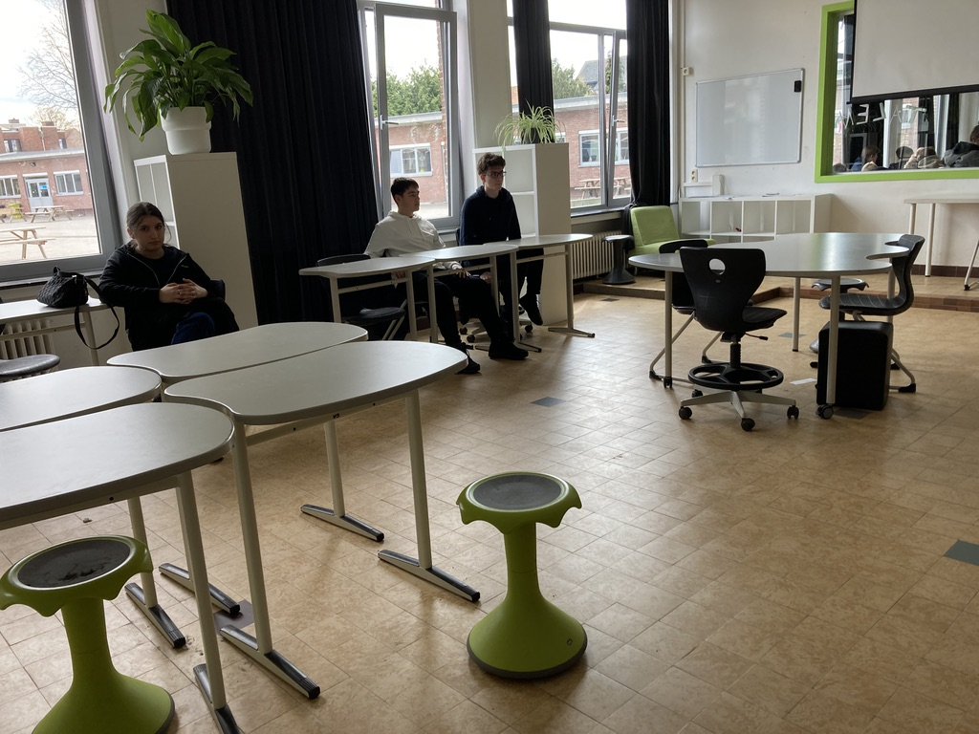
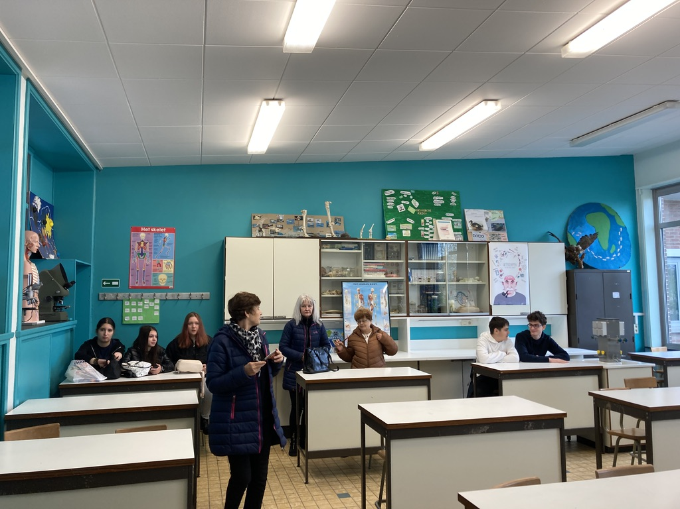
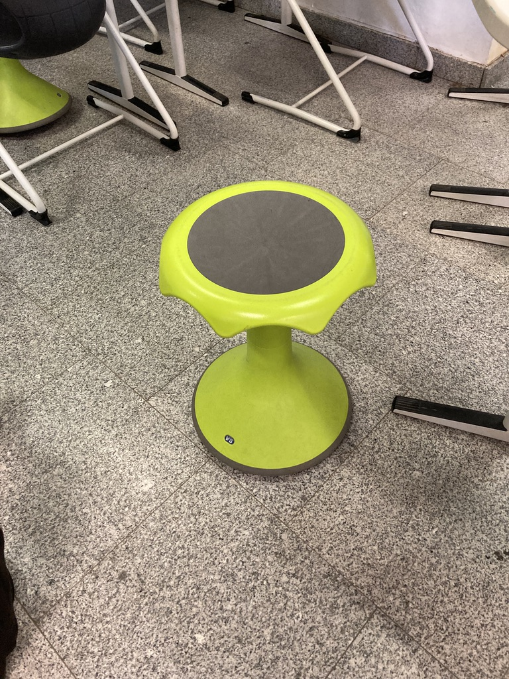

Slide 16
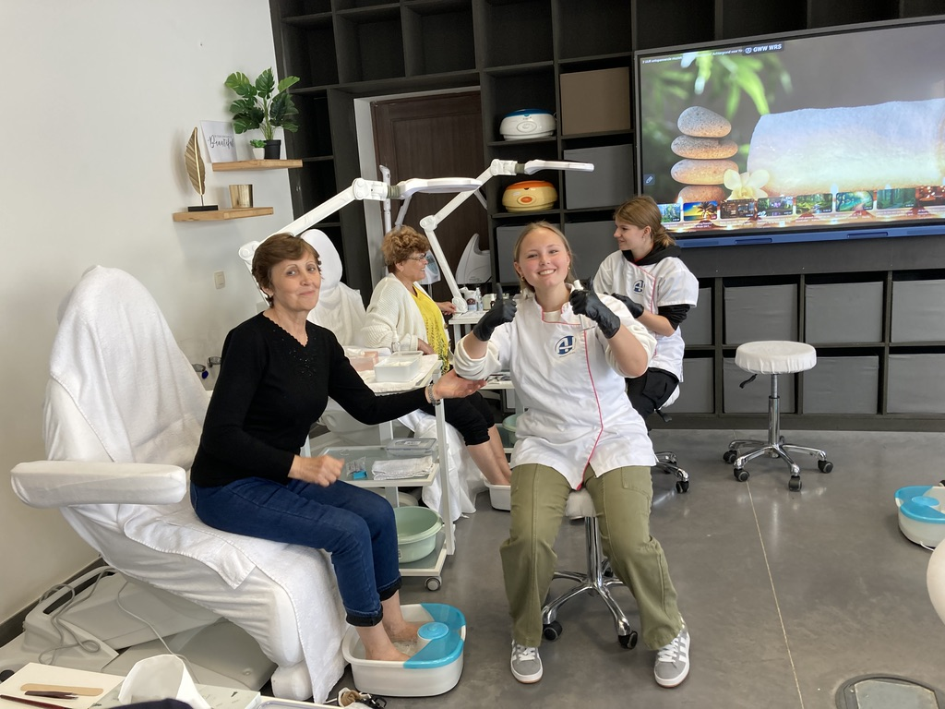
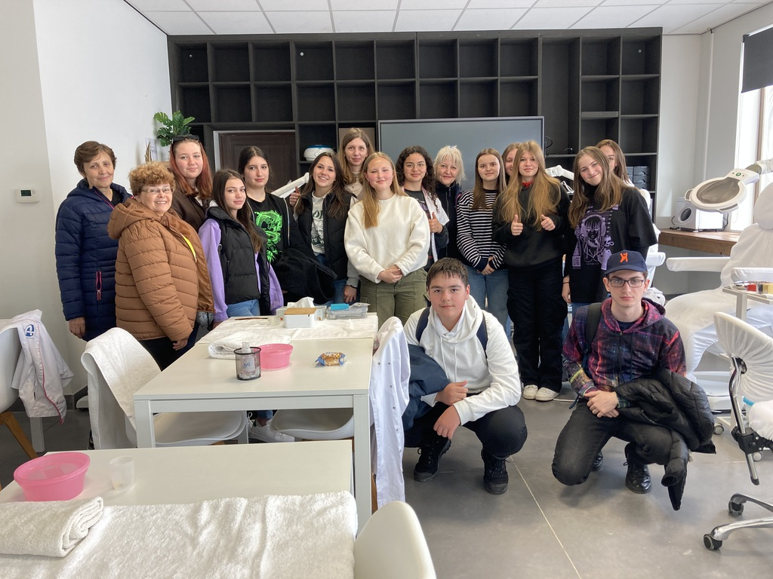
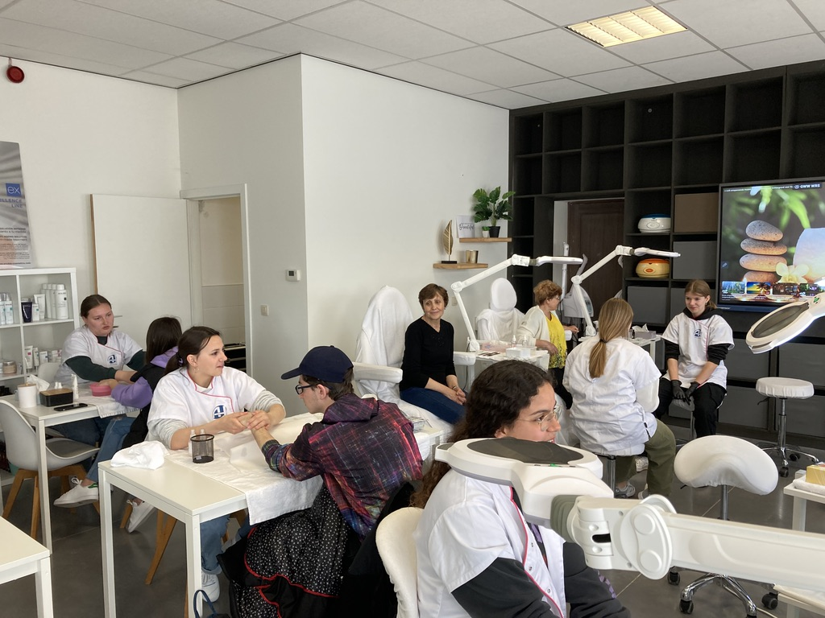
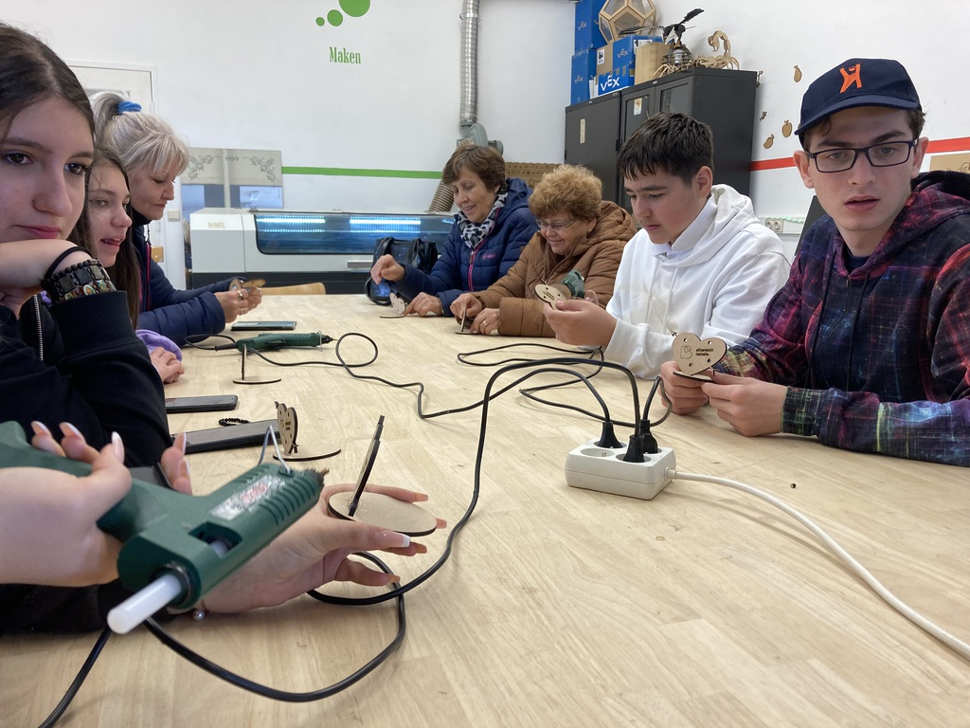
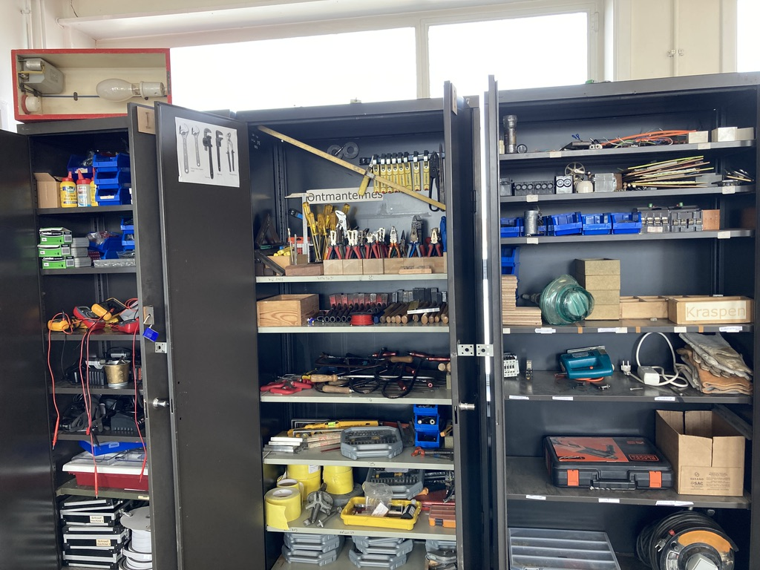
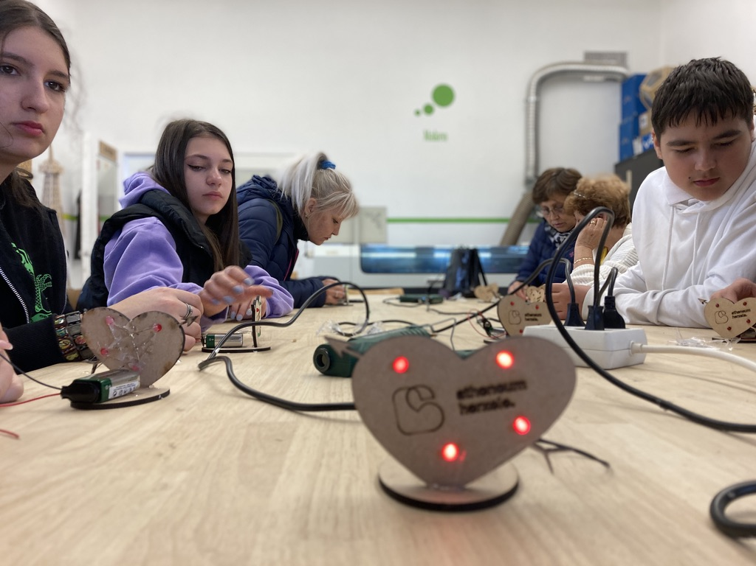
Content

Slide 17
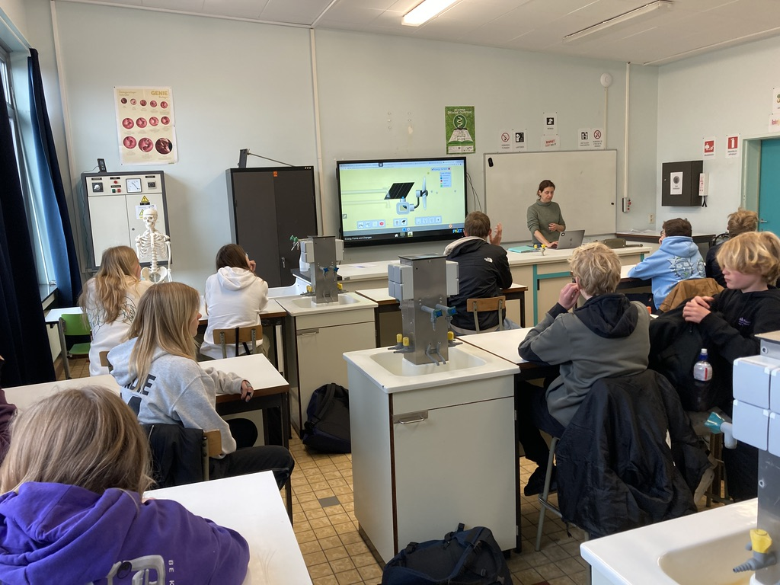
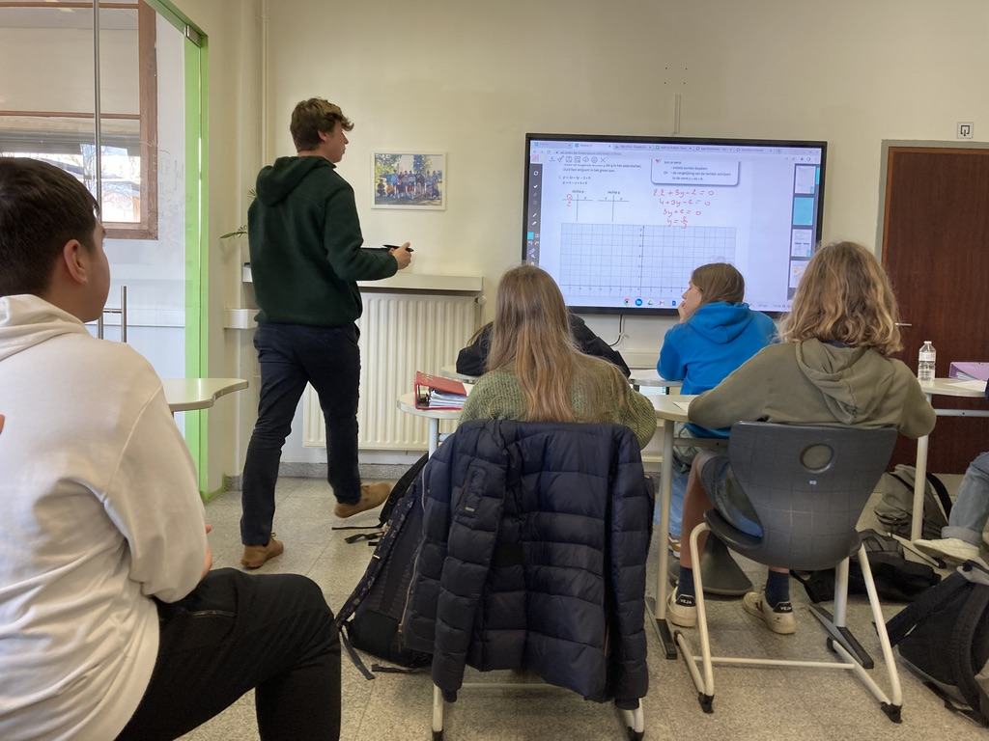
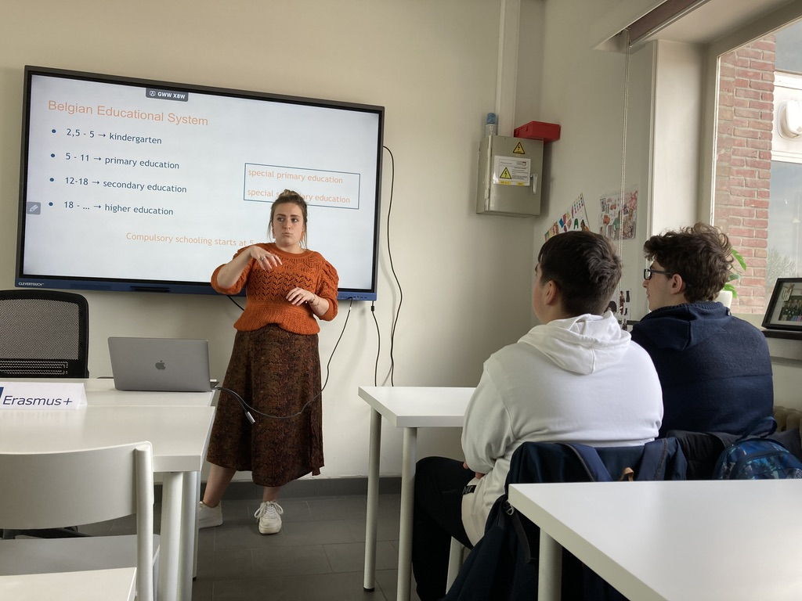
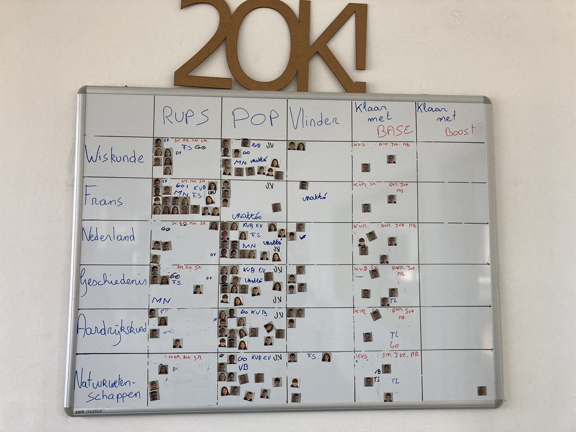
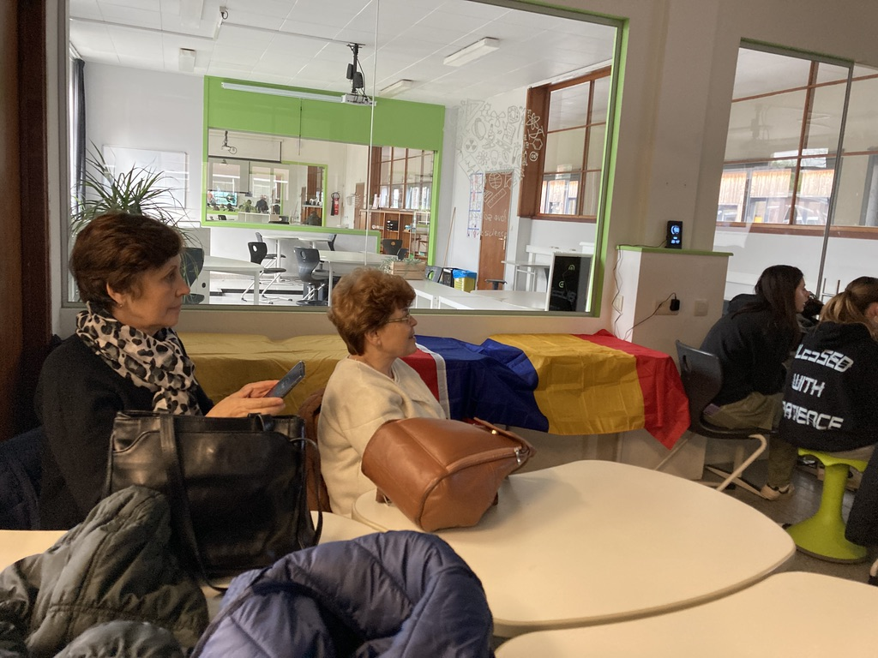
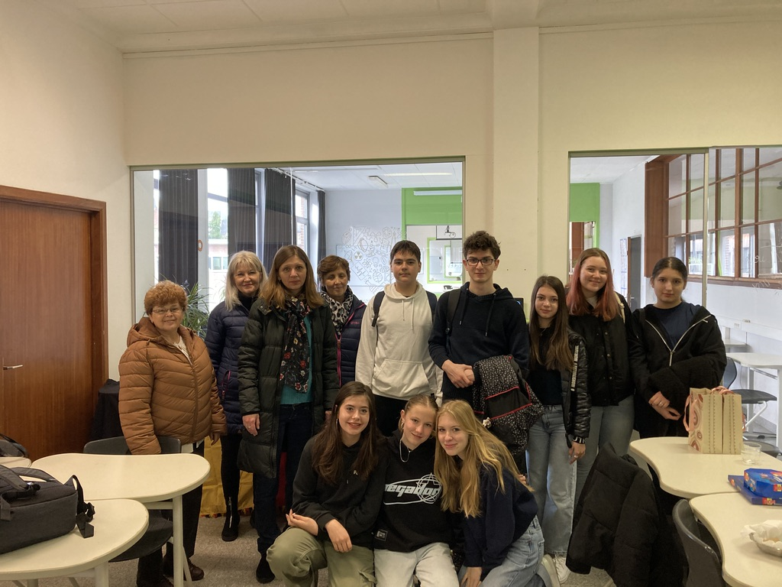
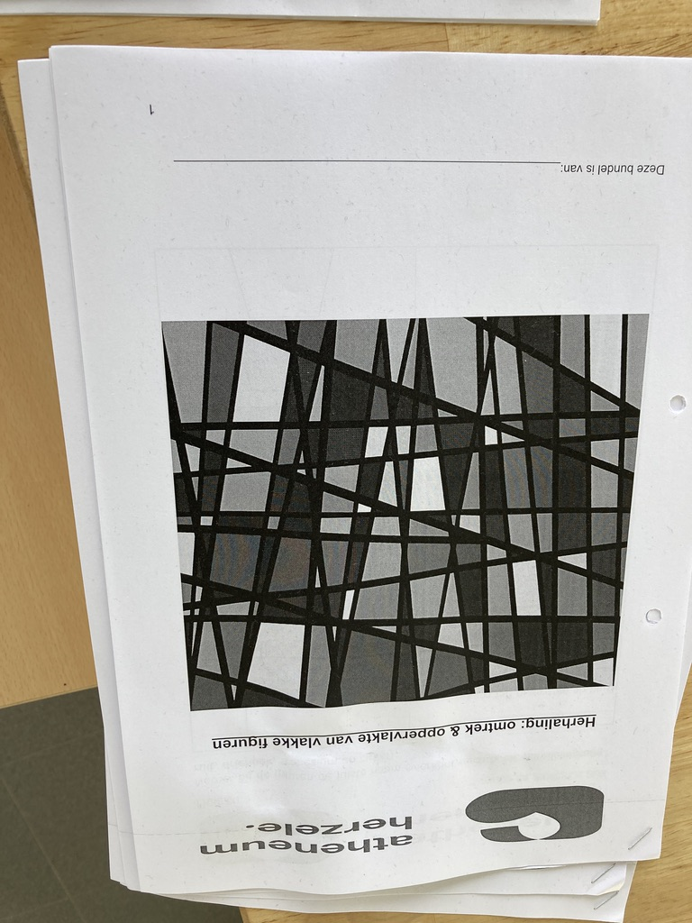

Slide 18
